Slide 1

LOGO
Web-Scraping
https://www.freeppt7.com

Slide 2
LOGO
What is Web Scraping?
Automatic method to obtain large amount of data from websites.
Converting unstructured HTML or other data to structured data format.
For instance, we can visit website like Amazon, Flipkart it has huge amount of data and if we want to extract it then web scraping is used.

Slide 3
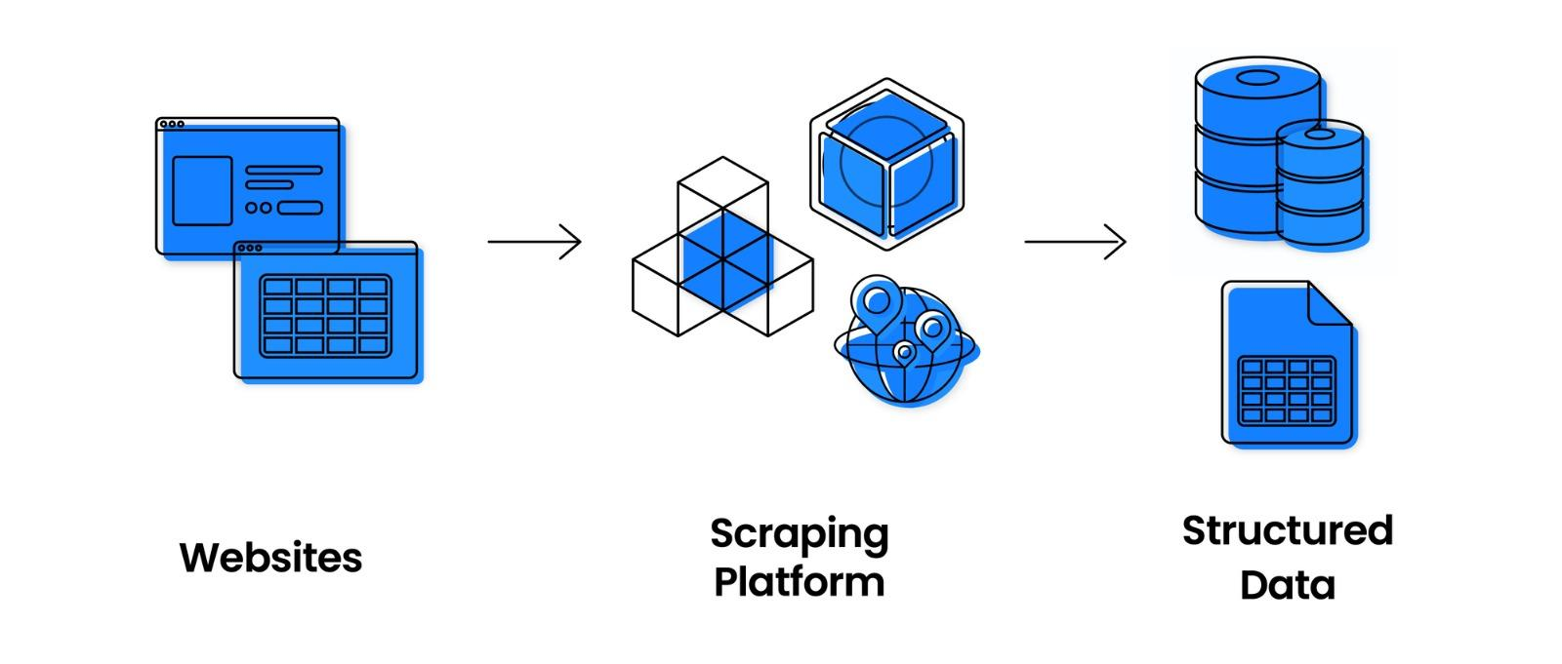
LOGO

Slide 4
Key-Points
Web Scraping can be performed using python libraries such as beautifulsoup, Selenium, framework such as Scrapy.
The extracted data can be used for making analysis,making predictions and can be used in other websites.
Used in Price Monitoring,Market Research,News Monitoring,Sentimental Analysis,Email Marketing.

Slide 5
LOGO
Why Scraping?
Company can scrape their product data and competing products as well to see how it impacts their pricing strategies and fix to optimal pricing.
80%
90%
70%
Helps in analysing consumer trends and understanding which direction the company should move in future.
Here helps to extract the versions,eol dates,year of release,name,ip addresses,host names.

Slide 6
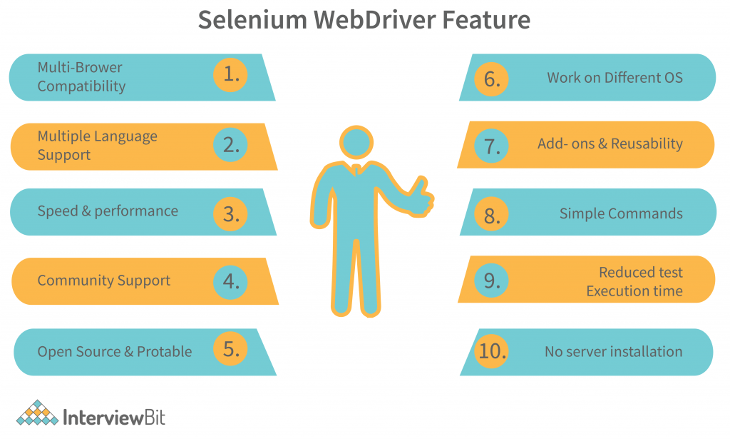


Slide 7
LOGO
Selenium is a powerful tool for controlling web browsers through programs and performing browser automation.
It is functional for all browsers, works on all major OS and its scripts are written in various languages in Python, Java.
Compatible with various languages ,platforms, browsers
An important component of Selenium is a webdriver which is similar to a API, it is nothing but a module which contains classes functions, methods.

Slide 8
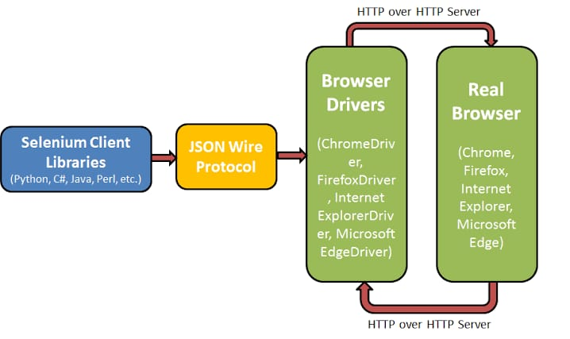
Selenium Architecture

Slide 9
Selenium Architecture
Selenium Client Library : Selenium Developers have developed libraries for various languages.
JSON Wire Protocol : Used to make interaction between the client and server.
Acts as the intermediate between client and server and converts the request generated by client in a format which is understood by server and same for the response.
Browser driver: Enables a secure connection with the browser without revealing its internal logic.

Slide 10
LOGO
Key Points
Install Selenium→ pip install selenium
Selenium requires driver to interface with the chosen browser.
Different types of drivers available in Selenium WebDriver are:
1.ChromeDriver
2.FirefoxDriver
3.InternetExplorerDriver
4.EdgeDriver
5.RemoteWebDriver

Slide 11
LOGO
Key Points
Install a webdriver compatible with our chrome version .
Import libraries services, by and ChromeDriverManager from selenium.
Create driver by providing the appropriate browser path
Open the website by driver.get(“url”)
Identify the tags and find elements by specifying their XPATH
XPATH→contains path of the element situated at the web page
Syntax:
//tag_name[@attribute=’value’]

Slide 12
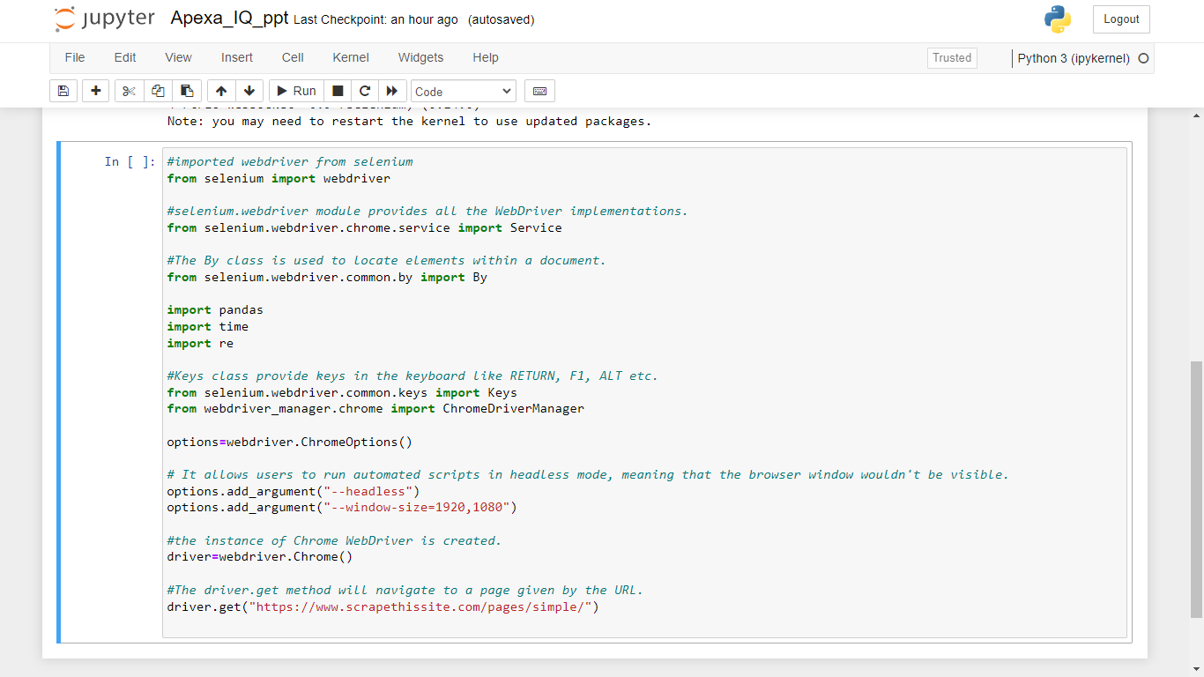
LOGO

Slide 13
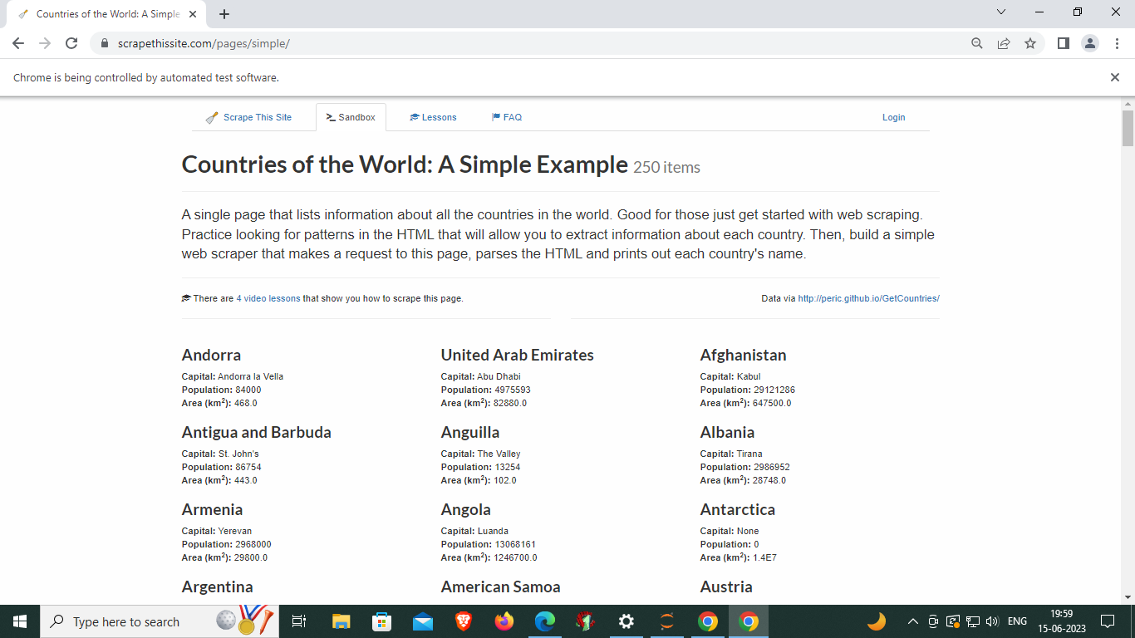
LOGO

Slide 14
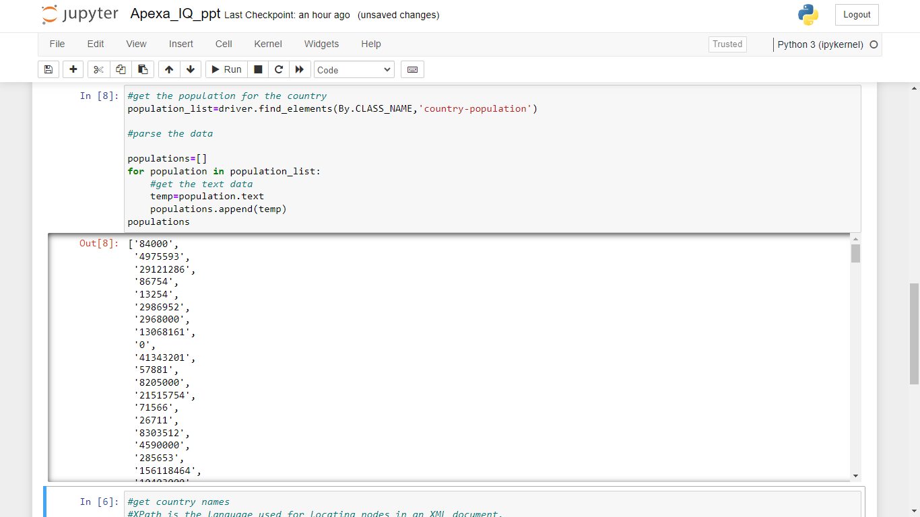
LOGO

Slide 15
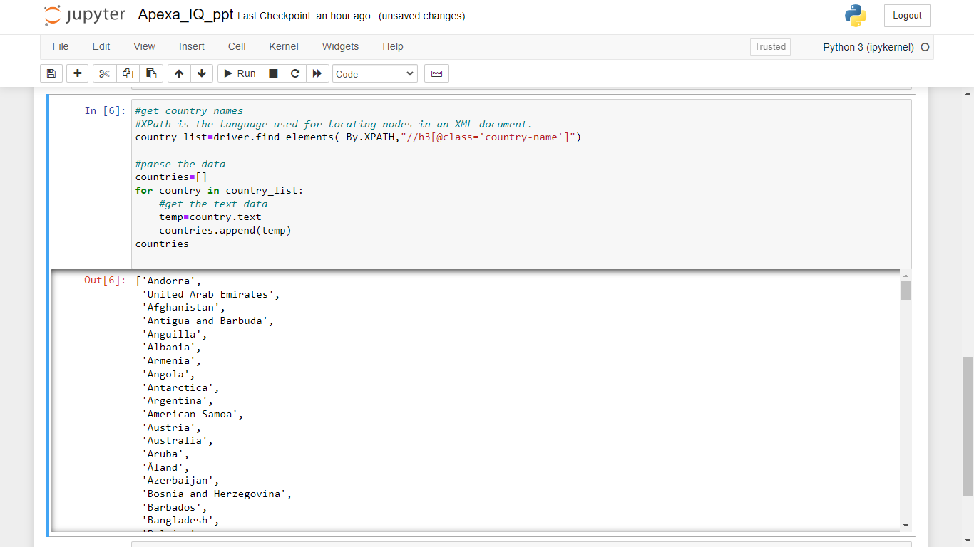
LOGO

Slide 16
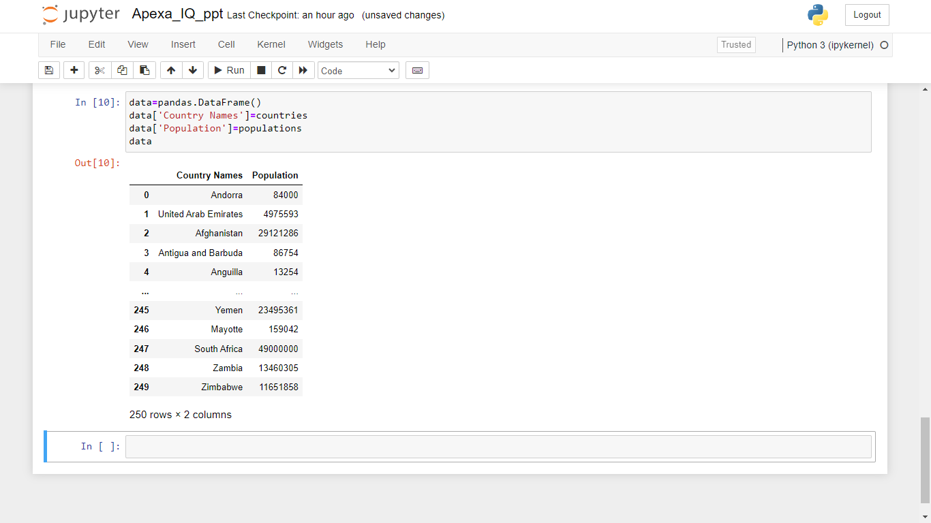
LOGO

Slide 17
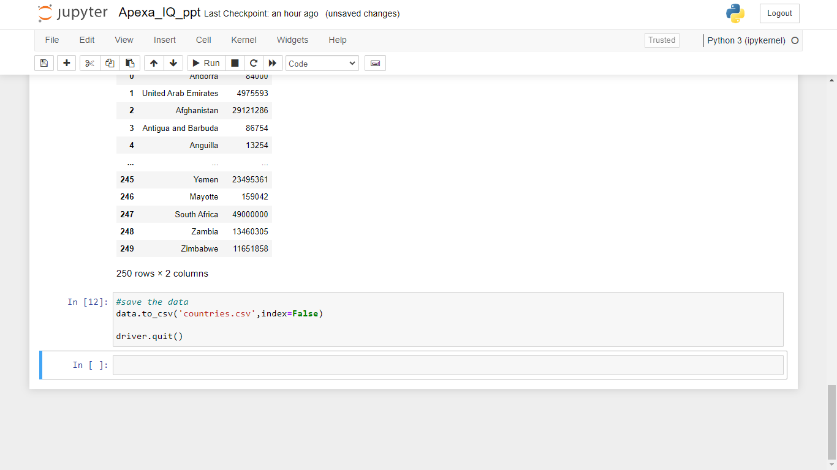
LOGO

Slide 18
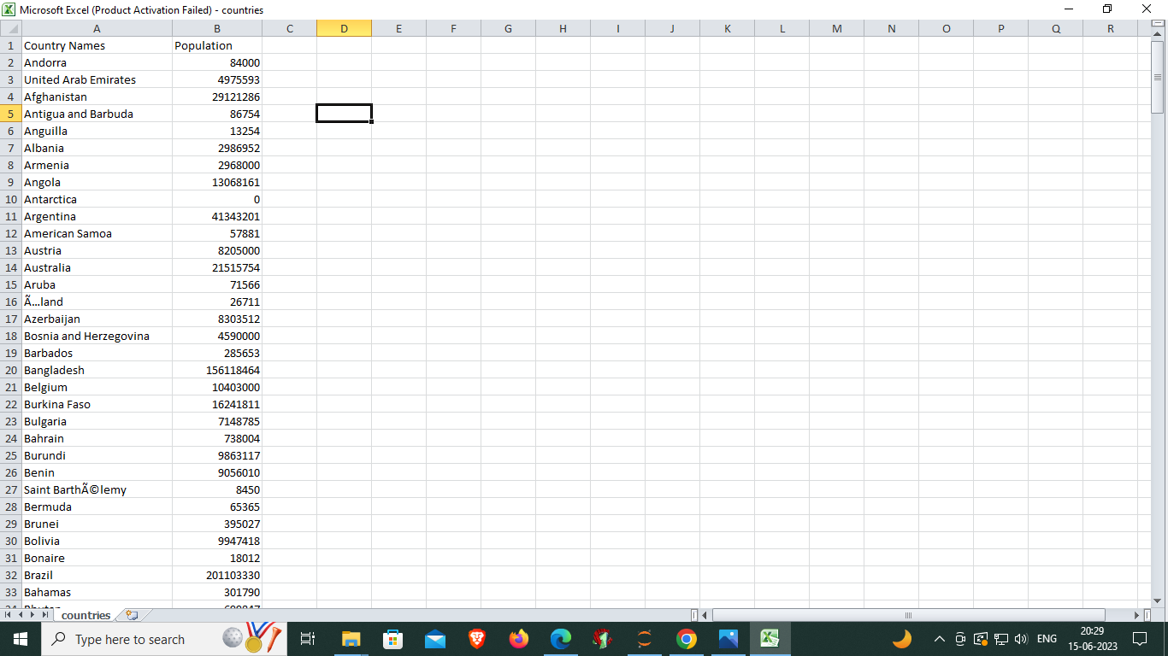
LOGO

Slide 19
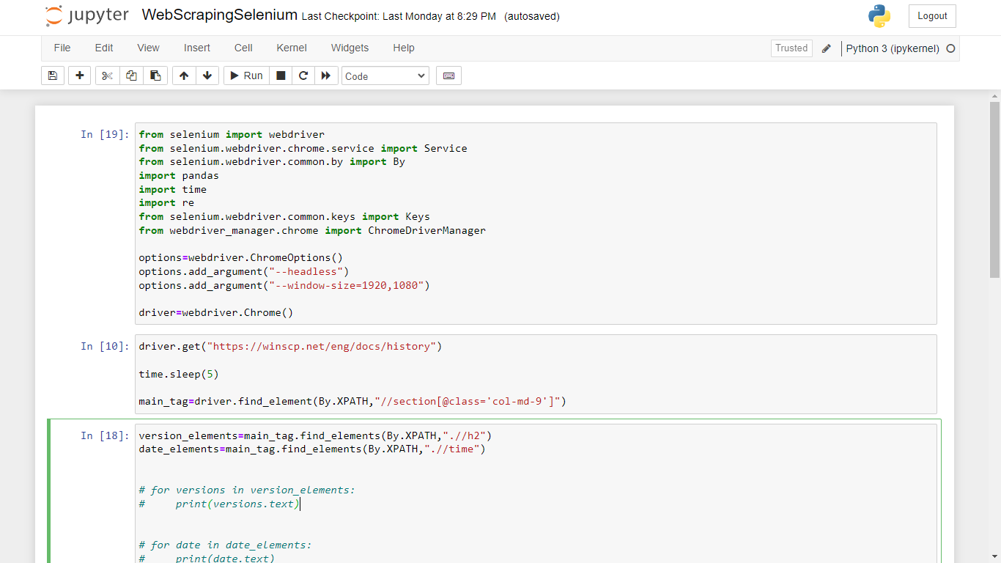
LOGO

Slide 20
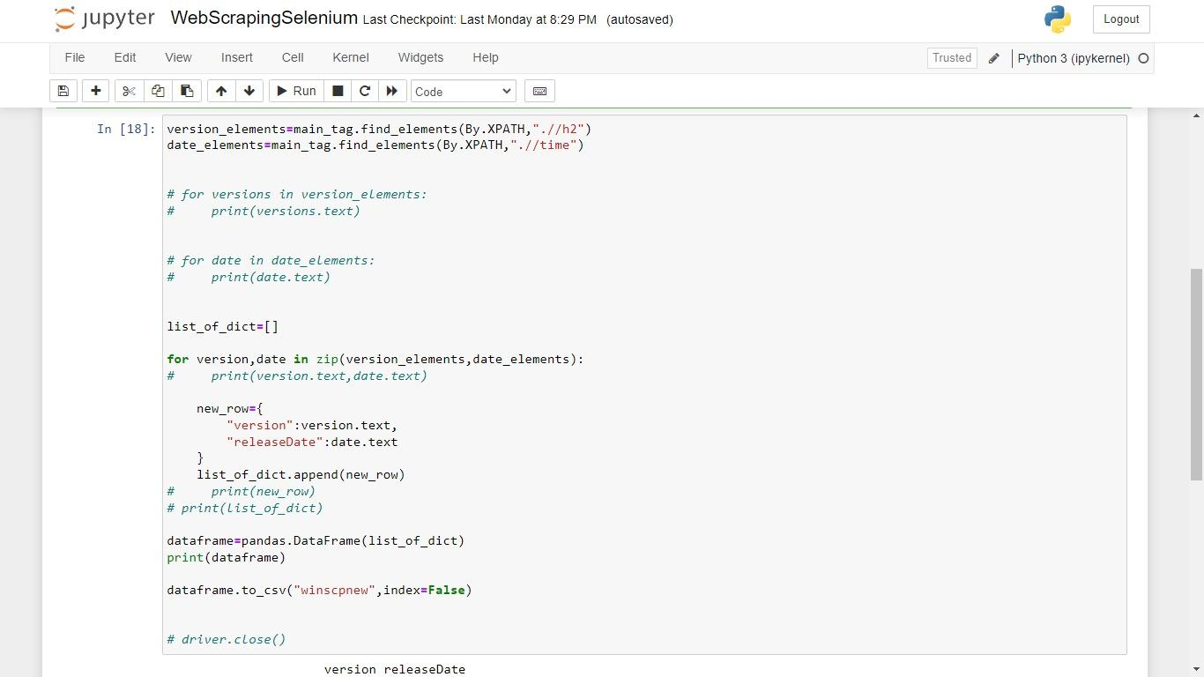
LOGO

Slide 21
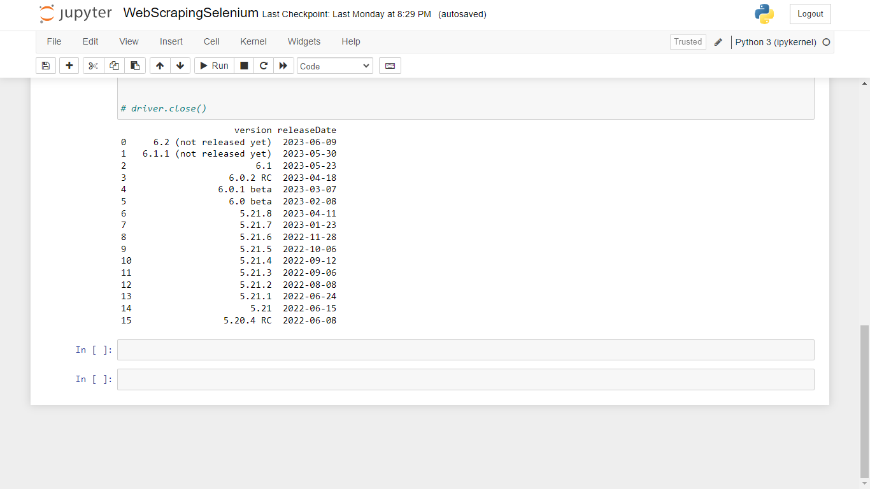
LOGO

Slide 22
THANKS
https://www.freeppt7.com

